Slide 1


Oracle PL/SQL
PL/SQL Functions

Slide 2
Agenda
01
02
DUAL Table
PL/SQL Functions
03
04
PL/SQL Built-in Functions
PL/SQL Single-row Functions
05
06
PL/SQL: Conversion Functions
PL/SQL: Analytic Functions
07
08
PL/SQL: User-defined Function
PL/SQL: Procedures

Slide 3
DUAL Table
It has one row called ‘X’ and one column called ‘DUMMY.’
The DUAL table is used to create SELECT statements and execute functions that are not directly related to a specific database table.
Queries using a DUAL table return one row as a result.
DUAL can be useful to do calculations and also to evaluate expressions that are not derived from a table.
DUMMY
X

Slide 4
DUAL Table
DUAL will be used to earn many of the single-row functions.
SELECT(319/29) + 12 FROM DUAL;
Here, the SELECT statement returns a value that does not exist in the DUAL table.
The value returned is a result of the calculation executed.
(319/29)+12
23

Slide 5
PL/SQL Functions

Slide 6
Functions in PL/SQL
Functions are small programs that preform an action on a value or column and produce something different as the output.
In SQL, there are many types of functions that are used to transform an input in one form to an output in another form.
These functions are used to manipulate data values.
Functions have both input and output. The input into a function is referred to as an argument.
Input (Argument)
Function
Output
Money (Argument)
Drinking Machine
Drink

Slide 7
Functions in PL/SQL
Functions are a very powerful feature of SQL. They are used to transform an input in one form to an output in another form. They can be used to:
Perform calculations on data
Modify individual data items
Manipulate input for groups of rows
Format dates and numbers for display
Convert column data types
SQL functions sometimes take arguments and always return a value.
Function
Output
Input
Function performs action
Arg 1
Arg 2
Result Value
Arg n
Money (Argument)
Drinking Machine
Drink

Slide 8
Types of PL/SQL Functions
Functions
Built-in
Functions
User-defined
Functions

Slide 9
Built-in Functions

Slide 10
Types of Built-in Functions
Built-in Functions
Single-row
Functions
Multi-row
Functions
Operate on single rows only and return one result per row
Manipulate groups of rows to give one result per group. They are also known as group functions

Slide 11
Single-row Functions

Slide 12
Single-row Functions
Manipulate data items
Accept arguments and return one value
Act on each row returned
Return one result per row
May modify the data type
Can be nested
Accept arguments which can be a column or an expression
function_name[(arg1, agr2…)]

Slide 13
Single-row Functions
Single-row Functions
General
Conversion
Date
Number
Character
Accepts character input and can return both character and number values
Converts a value from one data type to another
Operates on values of number and float
Operates on values of the DATE data type

Slide 14
Case Manipulation Functions
Used to know in which case (upper, lower, or mixed) the data is stored in the database
These functions convert case for character strings
Use of Function | Result
Select LOWER(‘SQL Course’) from dual; | sql course
Select UPPER(‘SQL Course’) from dual; | SQL COURSE
Select INITCAP (‘SQL Course’) from dual; | Sql Course
SELECT job, salary FROM emp WHERE LOWER (name) = ‘smith’;
SELECT ‘The job id for’ || UPPER (last_name) || ‘is’ || LOWER(job_id) AS “EMPLOYEE DETAILS” FROM emp;

Slide 15
Character Manipulation Functions
These functions manipulate character strings
Use of Function | Result
Select concat('Hello), 'World') from dual; | HelloWorld
Select SUBSTR('HelloWorld',1,5) from dual; | Hello
Select LENGTH('HelloWorld') from dual; | 10
Select INSTR('HelloWorld', 'W') from dual; | 6
Select LPAD(salary,10,'*')from dual; | *****24000
Select RPAD(salary, 10, '*')from dual; | 24000*****
Select TRIM('H' FROM'HelloWorld') from dual; | HelloWorld
Select empno, name, length(name), substr(job,1,3), instr (job,’A’) from emp;

Slide 16
Number Functions
Numeric functions accept numeric input and return numeric values.
ABS
SIGN(Expr)
Power
Returns absolute value ABS(number)
If Expr > 0, returns = 1; if Expr < 0, returns = −1; and if Expr = 0, returns = 0
Returns power
POWER(M,N)
Select ABS(-10) FROM DUAL
Select SIGN(100) from dual; --output: 1
Select POWER(3,2) from dual; --output: 9
SORT
ROUND
TRUNC
MOD
Returns square root SORT(number)
Rounds value to a specified decimal
Truncates value to a specified decimal
Returns the remainder of division
Select SORT(25) from dual; --output: 5
ROUND(45.926, 2)=45.93
TRUNC(45.926, 2) =45.92
MOD(1600, 300) =100

Slide 17
Character Manipulation Functions
SELECT ROUND (45. 923,2), ROUND(45.923), ROUND (45.923, -2) FROM DUAL;
ROUND (45. 923,2)
45. 92
ROUND (45. 923)
45
ROUND (45. 923,-2)
0

Slide 18
Using the TRUNC Function
SELECT TRUNC (45. 923,2), TRUNC(45.923), TRUNC (45.923, -2) FROM DUAL;
TRUNC (45. 923,2)
45. 92
TRUNC (45. 923)
45
TRUNC (45. 923,-2)
0

Slide 19
Number Functions
Calculate the remainder salary after it is divided by 5,000 for all employees whose job title is SALESMAN
SELECT name, salary, MOD(salary, 5000) FROM emp
WHERE job = 'SALESMAN’;
CEIL()
FLOOR()
select floor(-9.4) from dual;
Greatest()
select greatest(5,6,7,8) from dual;
Least()
select least(5,6,7,8) from dual;
This function is used to round the given number to the highest number.
select ceil(-9.4) from dual;
This function is used to round the given number to the lowest number.
This function is used to return the maximum value from a list of numbers.
This function is used to return the minimum value from a list of numbers.

Slide 20
Working with Dates
Oracle database stores dates in an internal numeric format: century, year, month, day, hours, minutes, and seconds
The default date display format is DD-MON-YY
Allows you to store 21st century dates in the 20th century by specifying only the last two digits of the year
Allows you to store 20th century dates in the 21st century in the same way
SQL> SELECT name, hiredate
2 FROM emp
3 WHERE name like ‘A%’;
NAME HIREDATE
ADAMS 1983-01-12
ALLEN 1981-02-20
SQL> select sysdate from dual;
SYSDATE
29-NOV-16

Slide 21
Date Functions
Date functions operate on Oracle dates.
All date functions return a value with a DATE data type except the MONTHS_BETWEEN function, which returns a numeric data type value.
Function | Description
MONTHS_BETWEEN | Number of months between two dates
ADD_MONTHS | Adds calendar months to a date
NEXT DAY | Next day of a specified date
LAST_DAY | Last day of the month
ROUND | Rounds date
TRUNC | Truncates date
SYSDATE | Returns system date
EXTRACT | Extracts a part of the date

Slide 22
Date Functions
SQL> Select ADD_MONTHS(SYSDATE,12) from dual;
ADD_MONTH
25-NOV-17
SQL> Select ADD_MONTHSC11-APR-05',33 from dual;
ADD_MONTH
11-JUL-OS
SQL> select NEXT_DAY(sysdate,'FRIDAY') from dual;
NEXT_DAY(
02-DEC-16
SQL> SELECT LAST_DAY(SYSDATE) FROM DUAL;
LAST_DAY(
30-NOV-16
SQL> SELECT LAST_DAY('10-FEB-2016') FROM DUAL;
LAST_DAY(
29-FEB-16

Slide 23
Arithmetic with Dates
Add or subtract a number to or from a date for a resultant date value
Subtract two dates to find the number of days between those dates
Add hours to a date by dividing the number of hours by 24
Date + Number (Date)
Date − Number (Date)
Date − Date (Number of Days)
Date + Number/24 Date
Adds number of days to a date
Subtracts number of days from a date
Subtracts one date from another
Adds number of hours to a date
SELECT name, (SYSDATE-hiredate)/7 AS WEEKS
FROM emp
WHERE deptno = 30;

Slide 24
Conversion Functions

Slide 25
Conversion Functions
Used to convert data from one data type to another data type
Data Type Conversion
Implicit Data Type Conversion
Explicit Data Type Conversion

Slide 26
Implicit Data Type Conversion
If conversion is performed by Oracle, then it is called implicit data type conversion.
For assignments, Oracle Server can automatically convert the following:
From | To
VARCHAR2 or CHAR | NUMBER
VARCHAR2 or CHAR | DATE
NUMBER | VARCHAR2
DATE | VARCHAR2
SQL) -- Find the total salary of deptno 10
SQL) select sum(salary) from employee where deptno = '10’;
SUM(SALARY)
8750
For expression evaluation, Oracle Server can automatically convert the following:
From | To
VARCHAR2 or CHAR | NUMBER
VARCHAR2 or CHAR | DATE
SQL> select 1000 + '1000' from dual;
1000+'1000'
2000

Slide 27
Explicit Data Type Conversion
If conversion is performed by the User, then it is called explicit data type conversion.
There are three functions:
TO_CHAR
TO_NUMBER
TO_DATE
TO_NUMBER
TO_DATE
NUMBER
CHARACTER
DATE
TO_CHAR
TO_CHAR

Slide 28
TO_CHAR Function
TO_CHAR is used to convert a NUMBER/DATE value to CHAR type.
• Format elements are used with this function to convert a number value as a character.
TO_CHAR(number; 'format model)
9 | Represents a number
0 | Forces a zero to be displayed
$ | Places a floating dollar sign
L | Uses the floating local currency symbol
. | Prints a decimal point
, | Prints a thousand indicator
Select empno, name, T0_CHAR(salary19,999') from employee;
Select empno, name, T0_CHAR(salary199,991 from employee;
Select empno, name, TO_CHAR(salary/$9,9991 from employee;
Select empno, name, T0_CHAR(salary,18,8881 from employee; //invalid No. format

Slide 29
TO_CHAR Function with Date Type
TO_CHAR(date, 'format_model’)
Must be enclosed in single quotation marks and is case sensitive
Can include any valid date format element
Has an FM element to remove padded blanks or to suppress leading zeros
Is separated from the date value by a comma
Time elements format the time portion of the date
Add character strings by enclosing them in double quotation marks
Number suffixes spell out numbers
YYYY | Full year in numbers. Example: 2016
YEAR | Year spelled out
MM | 2-digit value for a month. Example: 01 for January
MONTH | Full name of the month. Example: January
MON | 3-letter abbreviation of a month. Example: Jan
DY | 3-letter abbreviation of a day of the week. Example: Mon
DAY | Full name of a day of the week
DD | Numeric day of a month
HH24:MI:SSAM | 15:45:32 PM
DD “of” MONTH | 12 of OCTOBER
Ddspth | fourteenth

Slide 30
Using TO_NUMBER and TO_DATE Functions
• Convert a character string to a number format using the TO_NUMBER function
TO_NUMBER(chart[, 'format model’])
SQL> select to_number('$1,000','L9,999') + 1500 from dual;
TO_NUMBER('$1,000’,’L9,999')+1500
2500
• Convert a character string to a date format using the TO_DATE function
TO_DATE(char[, 'format_model’])
SQL> select to_date('08/01/2016 ‘,’ 'dd/mm/yy')+10 from dual;
TO_DATE('
18-JAN-16

Slide 31
Analytic Functions

Slide 32
Analytic Functions
Give an aggregate result; they do not group the result set
Return the aggregate value multiple times with each record
Are used to compute aggregates
Allows you to calculate:
Rankings and Percentiles
Moving Window Calculations
Lag/Lead Analysis
First/Last Analysis
Linear Regression Statistics
Any other non ‘group by’ column or expression can be presented in the select clause
For example: The columns, empno and salary

Slide 33
Analytic Functions: Syntax
The general syntax of analytic functions is:
Function(argl,..., argn) OVER ( [PARTITION BY <...>] [ORDER BY <....>][<window_clause>] )
<window_clause> is like "ROW <?>" or "RANK <?>"
Analytic functions are computed after all joins, such as WHERE clause, GROUP BY, and HAVING, are computed on the query.
The main ORDER BY clause of the query operates after analytic functions.
They can only appear in the select list and in the main ORDER BY clause of the query.
OVER() without PARTITION or <window_clause>
Over() acts on the entire record set returned by the WHERE clause.

Slide 34
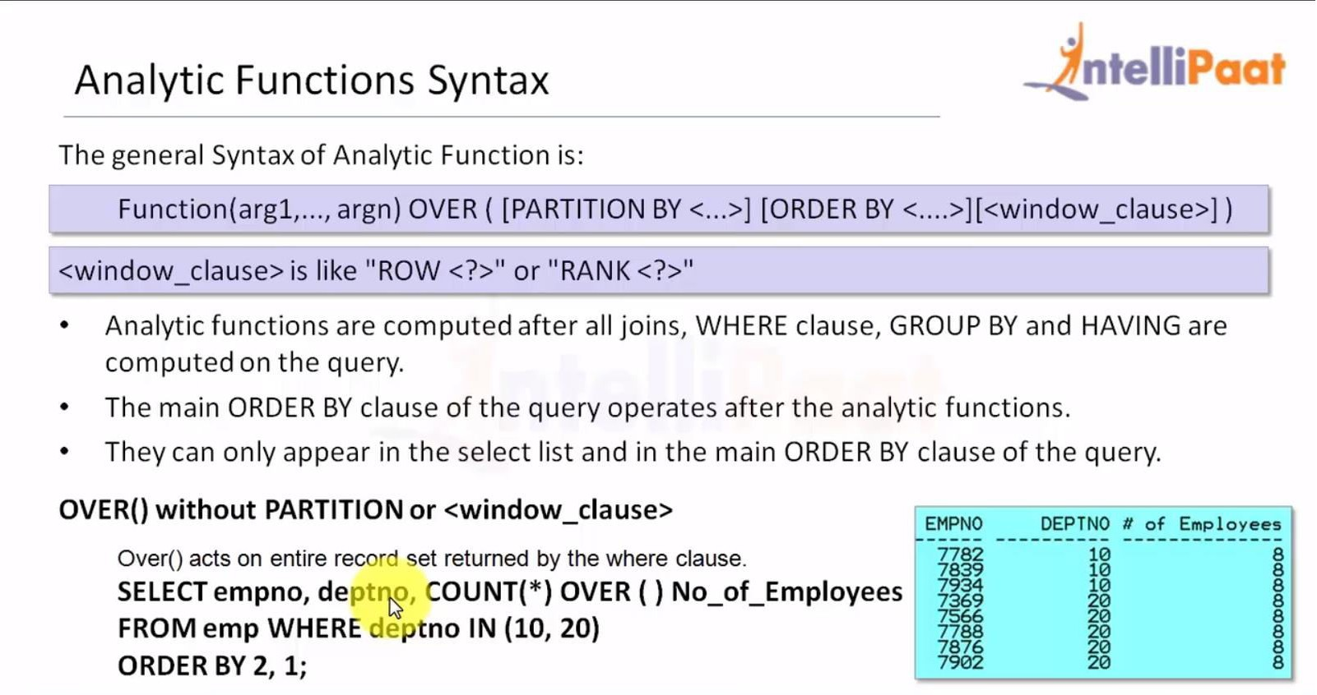
Analytic Functions: Example
SELECT empno, depty, COUNT(*) OVER ( ) No_of_Employees
FROM emp WHERE deptno IN (10, 20)
ORDER BY 2, 1;

Slide 35
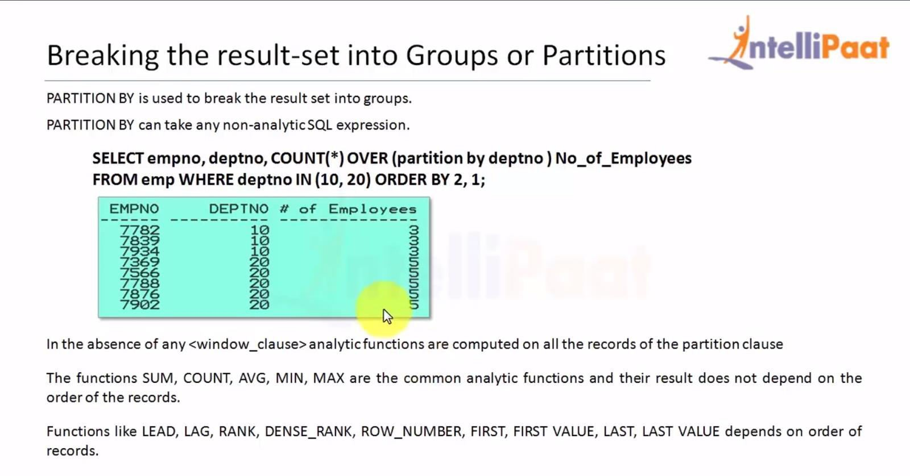
Breaking the Result Set into Groups or Partitions
PARTITION BY is used to break the result set into groups.
PARTITION BY can take any non-analytic SQL expression.
SELECT empno, deptno, COUNT(*) OVER (partition by deptno )
No_of_Employees
FROM emp WHERE deptno IN (10, 20) ORDER BY 2, 1;

Slide 36
Breaking the Result Set into Groups or Partitions
In the absence of any <window_clause>, analytic functions are computed on all records of the partition clause
Functions like SUM, COUNT, AVG, MIN, and MAX are the common analytic functions, and their results do not depend on the order of records
Functions like LEAD, LAG, RANK, DENSE_RANK, ROW_NUMBER, FIRST, FIRST VALUE, LAST, and LAST VALUE depend on the order of records

Slide 37
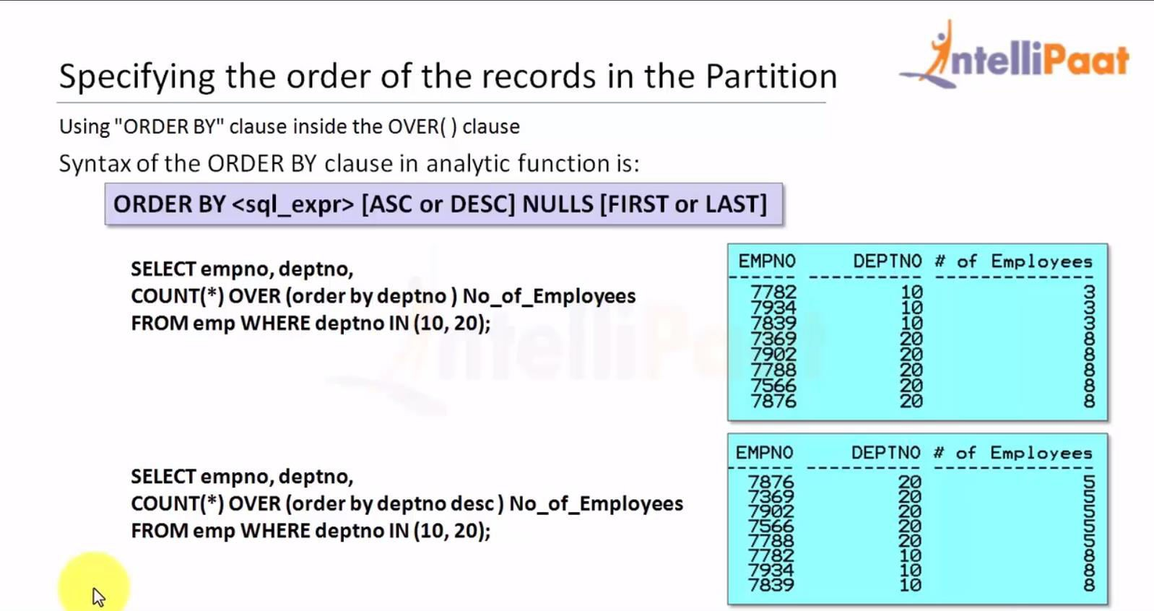
Specifying the Order of Records in Partition
By using the ‘ORDER BY clause inside the OVER() clause
Syntax of the ORDER BY clause in the analytic function is:
[ORDER BY <sql_expr> [ASC or DESC] NULLS [FIRST or LAST]
SELECT empno, deptno, COUNT(*) OVER (order by deptno ) No_of_Employees FROM emp WHERE deptno IN (10, 20)
SELECT empno, deptno, COUNT(*) OVER (order by deptno desc) No_of_Employees FROM emp WHERE deptno IN (10, 20)

Slide 38
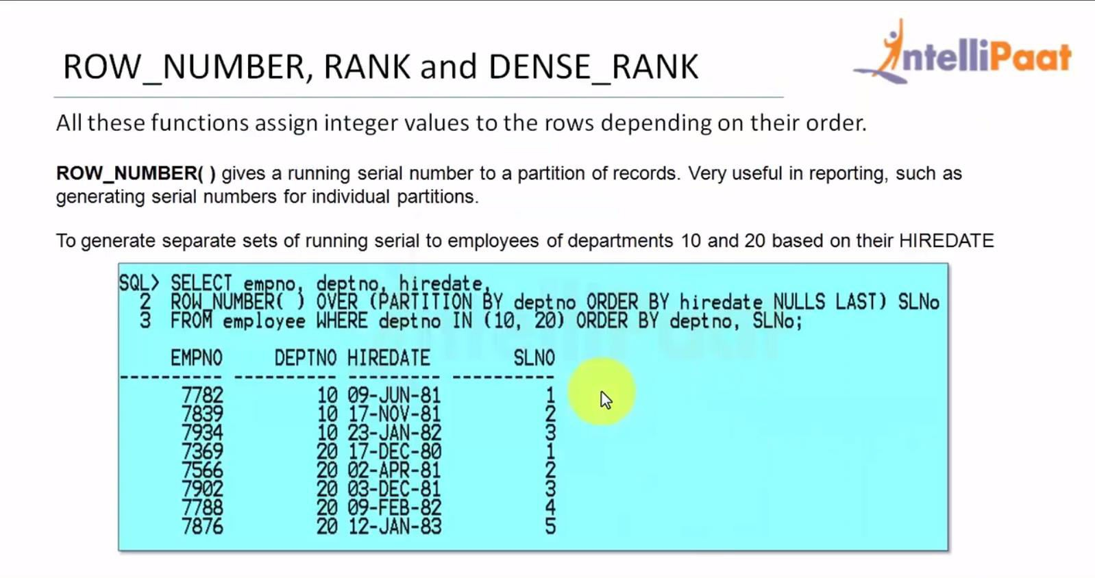
ROW NUMBER, RANK, and DENSE_RANK
All these functions assign integer values to rows depending on their order.
ROW_NUMBER() gives a running serial number to a partition of records.
They are very useful in reporting, such as for generating serial numbers for individual partitions.
To generate separate sets of running serial for employees of departments 10 and 20 based on their HIREDATE:

Slide 39
RANK and DENSE RANK
These functions compute the rank of a record in comparison with other records in a data set based on the values.
RANK() ranks items in a group by leaving gaps in the ranking sequence when there are ties.
DENSE_RANK() ranks items in a group leaving no gaps in the ranking sequence when there are ties.
In case of a tie between two records at a position N, RANK() declares two positions; it skips the position N+1 and gives the position N+2 to the next record. While DENSE_RANK() also declares two positions but does not skip the position N+1.

Slide 40
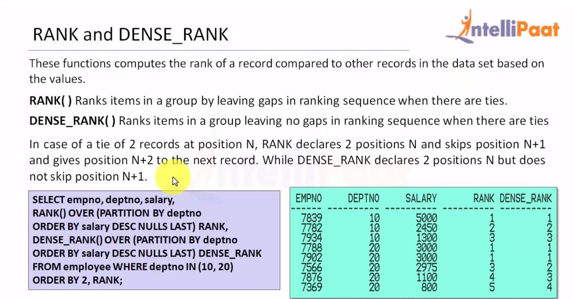
RANK and DENSE RANK
SELECT empno, deptno, salary,
RANK() OVER (PARTITION BY deptno
ORDER BY salary DESC NULLS LAST) RANK,
DENSE RANK() OVER (PARTITION BY deptno
ORDER BY salary DESC NULLS LAST) DENSE_RANK
FROM employee WHERE deptno IN (10, 20)
ORDER BY 2, RANK;

Slide 41
LEAD and LAG
They are useful for comparing values when the relative positions of rows can be known reliably.
LAG function provides access to a row at a given offset prior to the current position.
LEAD function provides access to a row at a given offset after the current position.
where:
<sql_expr> is the expression to compute from the leading row
<offset> is the index of the leading row relative to the current row for LEAD, whereas a previous row for LAG
<offset> is a positive integer with a default value, 14
<default> is the value to return if the <offset> points to a row outside the partition range
LAG / LEAD (<sql_expr>. <offset>. <default>) OVER (<analytic_clause>)

Slide 42
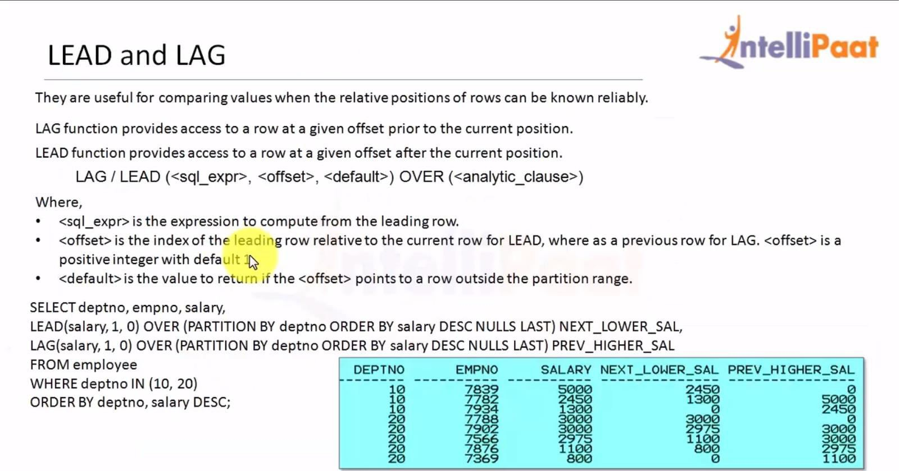
LEAD and LAG
SELECT deptno, empno, salary,
LEAD(salary, 1, 0) OVER (PARTITION BY deptno ORDER BY salary DESC NULLS LAST) NEXT_LOWER_SAL,
LAG(salary, 1, 0) OVER (PARTITION BY deptno ORDER DESC NULLS LAST) PREV_HIGHER_SAL
FROM employee
WHERE deptno IN (10, 20)
ORDER BY deptno, salary DESC;

Slide 43
Advanced Functions

Slide 44
BFILENAME Function
Returns a BFILE locator for a physical LOB binary file
Syntax
BFILENAME( 'directory', 'filename' )
Serves as an alias for the full path where the file is located on the file server
The name of the file on the file server

Slide 45
CARDINALITY Function
Returns a number of elements in a nested table
If the nested table is empty, the CARDINALITY function will return NULL
If the nested table is a null collection, the CARDINALITY function will return NULL
Syntax
CARDINALITY( nested_table_column )
The column in the nested table that you wish to return the cardinality for

Slide 46
CASE Statement
The Oracle/PLSQL CASE statement has the functionality of an IF-THEN-ELSE statement. Starting in Oracle 9i, you can use the CASE statement within a SQL statement.
Syntax
CASE [ expression ]
WHEN condition_1 THEN result_1
WHEN condition_2 THEN result_2
...
WHEN condition_n THEN result_n
ELSE result
END

Slide 47
COALESCE Function
It returns the first non-null expression in the list. If all expressions evaluate to null, then the COALESCE function will return null.
Syntax
COALESCE( expr1, expr2, ... expr_n )

Slide 48
DECODE Function
The Oracle/PLSQL DECODE function has the functionality of an IF-THEN-ELSE statement.
Syntax
DECODE( expression , search , result [, search , result]... [, default] )

Slide 49
EMPTY_BLOB Function
It is used to initialize a LOB column to EMPTY in an INSERT or UPDATE statement, or it can be used to initialize a LOB variable.
Syntax
EMPTY_BLOB ()

Slide 50
EMPTY_CLOB Function
It is used to initialize a LOB column to EMPTY in an INSERT or UPDATE statement, or it can be used to initialize a LOB variable.
Syntax
EMPTY_CLOB ()

Slide 51
GROUP_ID Function
It assigns a number to each group resulting from a GROUP BY clause. The GROUP_ID function is most commonly used to identify duplicated groups in your query results.
Syntax
SELECT column1, column2, ... column_n, GROUP_ID()
FROM tables
WHERE conditions
GROUP BY column1, column2, ... column_n;

Slide 52
LNNVL Function
It is used in the WHERE clause of a SQL statement to evaluate a condition when one of the operands contains a NULL value.
Syntax
LNNVL( condition )

Slide 53
NANVL Function
It lets you substitute a value for a floating point number such as BINARY_FLOAT or BINARY_DOUBLE, when a NaN (Not a Number) value is encountered.
Most commonly, it is used to convert NaN values to either NULL or 0.
Syntax
NANVL( value, replace_with )

Slide 54
NULLIF Function
It compares expr1 and expr2. If expr1 and expr2 are equal, the NULLIF function returns NULL. Otherwise, it returns expr1.
Syntax
NULLIF( expr1, expr2 )

Slide 55
NVL Function
It lets you substitute a value when a null value is encountered.
Syntax
NVL( string1, replace_with )

Slide 56
NVL2 Function
This extends the functionality of the NVL function. It lets you substitutes a value when a null value is encountered, and also when a non-null value is encountered.
Syntax
NVL2( string1, value_if_not_null, value_if_null )

Slide 57
SYS_CONTEXT Function
It is used to retrieve information about the Oracle environment.
Syntax
SYS_CONTEXT( namespace, parameter [, length] )

Slide 58
UID Function
It returns the ID number for a user's session (when the user who is currently logged in).
Syntax
UID

Slide 59
USER Function
It returns the user_id from the current Oracle session.
Syntax
USER

Slide 60
USERENV Function
It is used to retrieve information about the current Oracle session. Although this function still exists in Oracle for backwards compatibility, it is recommended that you use the SYS_CONTEXT function instead.
Syntax
USERENV( parameter )

Slide 61
User-defined Functions

Slide 62
Create Function
Helps in extending SQL statements as well as modularizing and abstracting complex business logic
This function always returns a value and is used in expressions to assign a variable or to directly fetch values from SQL statements by performing insert, update, or delete operations on DML statements
IN
Referring to the procedure or function and allow to overwritten the value of parameter.
OUT
Can not be referenced by the procedure or function, but the value of the parameter can be overwritten by the procedure or function.
IN OUT
Referring to the procedure or function to pass both IN and OUT parameters, modify/update by the function or procedure, and get returned

Slide 63
Create Function: Syntax
CREATE [OR REPLACE] FUNCTION [SCHEMA..] function_name
[ (parameter [,parameter]) ]
RETURN return_datatype
IS | AS
[declaration_section
variable declarations;
constant declarations;
]
BEGIN
[executable_section
PL/SQL execute/subprogram body
]
[EXCEPTION]
[exception_section
PL/SQL Exception block
]
END [function_name];
/

Slide 64
Function Example
EMP_NO | EMP_NAME | EMP_DEPT | EMP_SALARY
1 | Forbs Ross | Web Developer | 45k
2 | Marks Jems | Program Developer | 38k
3 | Saulin | Program Developer | 34k
4 | Zenia Sroll | Web Developer | 42k
Create Function
PL/SQL Program to Calling Function
SQL>edit fun1
CREATE or REPLACE FUNCTION fun1(no in number)
RETURN varchar2
IS
name varchar2(20);
BEGIN
select ename into name from emp1 where eno = no;
return name;
END;
/
SQL>edit fun
DECLARE
no number :=&no;
name varchar2(20);
BEGIN
name := fun1(no);
dbms_output.put_line('Name:'||' '||name);
end;
/

Slide 65
PL/SQL DROP FUNCTION
You can drop a PL/SQL function using the DROP FUNCTION statement.
Syntax
DROP FUNCTION function_name;

Slide 66
PL/SQL Procedure

Slide 67
PL/SQL Procedure
Subprogram that returns multiple values
Allows you to centralize your business logic in the database
Used by any program that accesses the database
Syntax
CREATE [OR REPLACE] PROCEDURE procedure_name
[(parameter_name [IN | OUT | IN OUT] type [, ...])]
{IS | AS}
BEGIN
procedure_body
END procedure_name;

Slide 68
Procedure Example
EMP_NO | EMP_NAME | EMP_DEPT | EMP_SALARY
1 | Forbs Ross | Web Developer | 45k
2 | Marks Jems | Program Developer | 38k
3 | Saulin | Program Developer | 34k
4 | Zenia Sroll | Web Developer | 42k
Create Procedure
PL/SQL Program to Calling Procedure
SQL>dit pro1
CREATE or REPLACE PROCEDURE pro1(no in number,temp out emp1%rowtype)
IS
BEGIN
SELECT * INTO temp FROM emp1 WHERE eno = no;
END;
/
SQL>edit pro
DECLARE
temp emp1%rowtype;
no number :=&no;
BEGIN
pro1(no,temp);
dbms_output.put_line(temp.eno||' '||
temp.ename||' '||
temp.edept||' '||
temp.esalary||' '||);
END;
/

Slide 69
PL/SQL DROP PROCEDURE
You can drop a PL/SQL procedure using the DROP PROCEDURE statement.
Syntax
DROP PROCEDURE procedure_name;

Slide 70
Quiz

Slide 71
Quiz 1
The || is is an example of what function ? SELECT last_name || ', ' || first_name || ' ' || middle_name FROM employees;
A
Incantination
B
Integration
C
Continuation
D
Concatenation

Slide 72
Quiz 1
The || is is an example of what function ? SELECT last_name || ', ' || first_name || ' ' || middle_name FROM employees;
A
Incantination
B
Integration
C
Continuation
D
Concatenation

Slide 73
Quiz 2
In Oracle SQL, what is the command that returns the first non-null value in a list of values?
A
DECODE
B
COALESCE
C
INSTR
D
ISNOTNULL

Slide 74
Answer 2
In Oracle SQL, what is the command that returns the first non-null value in a list of values?
A
DECODE
B
COALESCE
C
INSTR
D
ISNOTNULL

Slide 75
Quiz 3
Which of the following is an explicit numeric, character, string, or BOOLEAN value not represented by an identifier?
A
Delimiters
B
Literals
C
Comments
D
None of the above

Slide 76
Answer 3
Which of the following is an explicit numeric, character, string, or BOOLEAN value not represented by an identifier?
A
Delimiters
B
Literals
C
Comments
D
None of the above

Slide 77
Quiz 4
Which of the following is used to declare a record?
A
%ROWTYPE
B
%TYPE
C
Both A and B
D
None of the above

Slide 78
Answer 4
Which of the following is used to declare a record?
A
%ROWTYPE
B
%TYPE
C
Both A and B
D
None of the above

Slide 79
Quiz 5
Like all identifiers, the names of constants, variables, and parameters are case sensitive.
A
True
B
False

Slide 80
Answer 5
Like all identifiers, the names of constants, variables, and parameters are case sensitive.
A
True
B
False

Slide 81

India: +91-7847955955
US: 1-800-216-8930 (TOLL FREE)
sales@intellipaat.com
24/7 Chat with Our Course Advisor
Notes:
Thank you!

